Slide 1
CELEBRATING THE CONTRIBUTION OF CORKS VOLUNTEERS
giving something back to those who give
Sponsor the Inaugural Cork Volunteer Ceremony Awards
Friday, 11th October | Kingsley Hotel

Slide 2
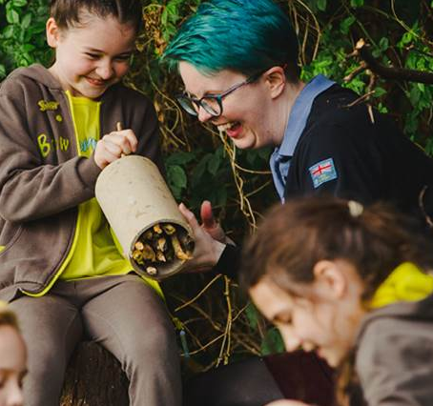
THE PEOPLE BEHIND VOLUNTEER CORK
‘I volunteer because I think working with people makes me feel good, and I like interacting with people. Volunteering is all about offering yourself, your time, without expecting anything in return. It helps with physical health, mental health and makes you feel good because you are interacting with different kinds of people from different backgrounds.
Smiley

Slide 3
​
This is a fantastic opportunity for a fun team night, a way for your organisation to connect with local Cork community groups, learning more about the corporate benefits of Volunteering, while sponsoring an award at our inaugural
Cork Volunteer Awards.

Slide 4
INAUGURAL CORK VOLUNTEERS AWARDS 2019
The Ceremony will take place Friday, 11th October, Kingsley Hotel, beginning with a wine reception at 7pm, with the ceremony taking place from 8pm. This event includes a 3 course sit-down dinner.
Patricia Messenger, presenter of C103 hit talk show 'Cork Today' will be the host on the night in addition to announcing the winners in the 11 award categories. Simon Murdoch, Host of ‘Cork’s More Music Breakfast’ on C103 will DJ on the night.

Slide 5
CORPORATE BENEFITS OF VOLUNTEERING
Help Employees to Build Their Skills
Boost Employee Engagement & Job Performance
Build Team Players
Improve Employee Retention
Boost Employee Goodwill & Morale
Boost Employer Reputation
Improve Corporate Visibility
Source: https://blog.optimy.com/5-key-benefits-corporate-volunteering-programs/

Slide 6
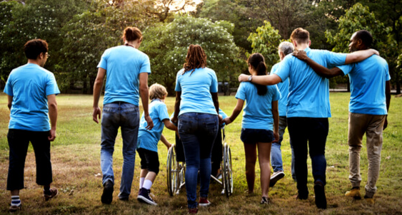
WHY SPONSOR AN AWARD?
Volunteers provide many key services that are often overlooked or under-acknowledged.
By sponsoring your chosen award your organisation will support our Volunteers while raising its profile in the Cork business community & the benefits of Volunteering within your team.
You will toast to the future with our Volunteer Award Winners, the inspirational people who give so much back to their local communities in Cork City and County.

Slide 7
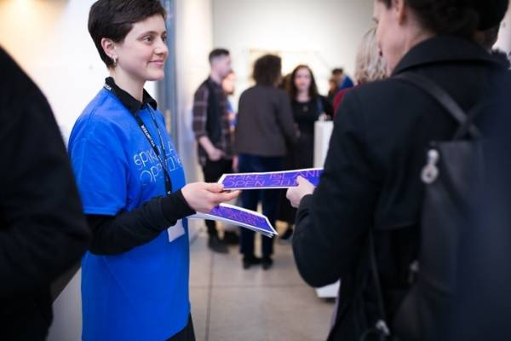
AWARDS
We are currently seeking corporate sponsorship for the following awards;
Volunteer of the Year - North Cork
Volunteer of the Year - East Cork
Volunteer of the Year - West Cork (Cramers Court Nursing Home)
Volunteer of the Year - North City (AIB)
Volunteer of the Year - South City (Douglas Contol & Automation)
Volunteer of the Year – Youth Award (Under 18) (OTTERBOX)
Volunteer of the Year - Student Award (Third Level)
Volunteer of the Year - Group Award (Cork City PPN)
Outstanding Lifetime Volunteer Achievement Award (First South Credit Union)
Volunteer of the Year – Board Member
Cork Volunteer of the year - (C103)

Slide 8
MEDIA PARTNERS
Notes:
Cork Volunteer Centre and C103 are delighted to announce that we are hosting the inaugural
Cork Volunteers Awards 2019.

Slide 9
PR & MARKETING OPPORTUNITIES for you
Coverage in the lead-up to and after the awards on C103 and Cork Independent newspapers (and their social media platforms)
Promotion of your business/service on Cork Volunteer Centre website and social media platforms.
Raise your profile across the Community and Voluntary sector in Cork
Cork Volunteer Centre is a registered charity therefore, companies can claim tax relief on donations (12.5% back)

Slide 10
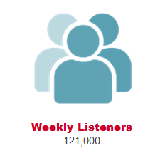
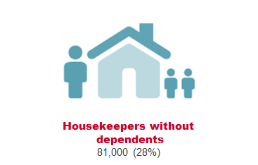
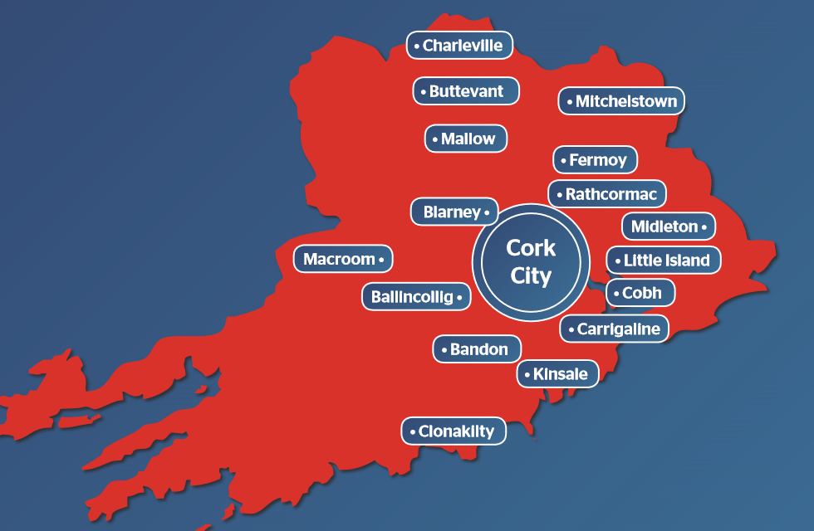
Why Cork Independent & C103 are right for your Business…

Slide 11
CORPORATE SPONSORSHIP OPTIONS
GOLD STAR OPTION | SILVER STAR OPTION | BRONZE STAR OPTION
Headline Sponsor - C103 €1,500 to sponsor your chosen award Provide a trophy with your company logo and the title of the award you sponsor Co-host of the awards ceremony Full table for 10 x people to attend | Minimum €500 to sponsor your chosen award and secure a table on the night Provide a trophy with your company logo and the title of the award you sponsor 2 seats at the table for your organisation for Sponsoring the award 2 seats on the table will be allocated for the Organisation that the Volunteering winner works for/comes from. 1 seats allocated for the Volunteer plus x5 of their guests | Provide a spot prize for the night (minimum value of €100) Your company will be mentioned at the event on the night and across our Media partners channels
Tables of 10 people. Individual tickets can be purchased for the night €50 for a seat.

Slide 12
MORE ABOUT CORKS VOLUNTEERS
Cork Volunteer Centre – The Facts
8,900 volunteers and 398 organisations registered with us
1000 follows on Instagram
2500 followers on Facebook
1200 followers on Twitter
Our website receives 10,000 visits per month
A member of Volunteer Ireland
Funded by the Department of Rural and Community Development.
A registered charity.
If you are interested in sponsoring an award please contact julie@volunteercork.ie for more details.

Slide 13
THANK YOU!
Cork Volunteers registered Charity Number | 20078195

